Slide 1
Course Name: Database Systems Course Code: CS52 Credits: 3:1:0 UNIT 4 Term: Oct 2021 – Feb 2022
M.S. Ramaiah Institute of Technology
(Autonomous Institute, Affiliated to VTU)
Department of Computer Science and Engineering
Faculty:
Sini Anna Alex

Slide 2
Inference Rules for FDs
Given a set of FDs F, we can infer additional FDs that hold whenever the FDs in F hold
Armstrong's inference rules:
IR1. (Reflexive) If Y subset-of X, then X -> Y
IR2. (Augmentation) If X -> Y, then XZ -> YZ
(Notation: XZ stands for X U Z)
IR3. (Transitive) If X -> Y and Y -> Z, then X -> Z
IR1, IR2, IR3 form a sound and complete set of inference rules
These are rules hold and all other rules that hold can be deduced from these

Slide 3
Inference Rules for FDs
Some additional inference rules that are useful:
Decomposition: If X -> YZ, then X -> Y and X -> Z
Union: If X -> Y and X -> Z, then X -> YZ
Psuedotransitivity: If X -> Y and WY -> Z, then WX -> Z
The last three inference rules, as well as any other inference rules, can be deduced from IR1, IR2, and IR3 (completeness property)

Slide 4
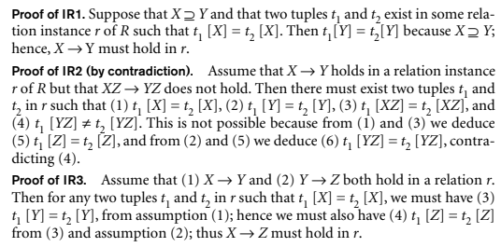
Proof of Inference Rules

Slide 5
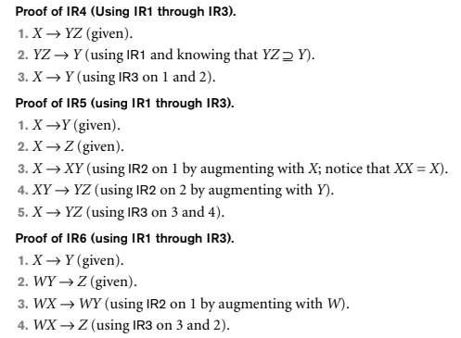
Proof of Inference Rules

Slide 6
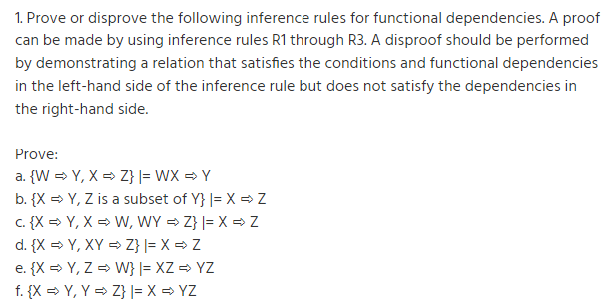

Problem on Inference Rules:

Slide 7
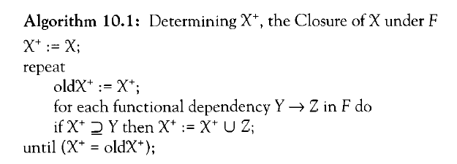
Closure of a set F of FDs
Closure of a set F of FDs is the set F⁺ of all FDs that can be inferred from F.
Closure of a set of attributes X with respect to F is the set X⁺ of all attributes that are functionally determined by X. X⁺ can be calculated by repeatedly applying IR1, IR2, IR3 using the FDs in F.

Slide 8
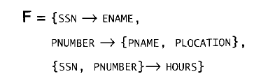

The following set F of functional dependencies that should hold on EMP_PROJ;
we calculate the following closure sets with respect to F;

Slide 9
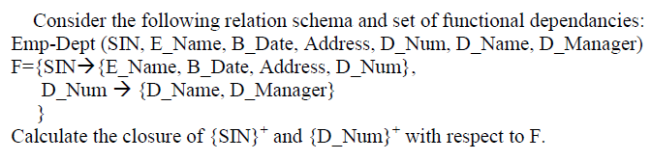
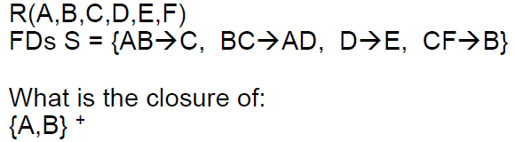
Problem:

Slide 10
Equivalence of Sets of Functional Dependencies
Two sets of FDs F and G are equivalent if:
Every FD in F can be inferred from G, and
Every FD in G can be inferred from F
Hence, F and G are equivalent if F⁺ =G⁺
Definition (Covers):
F covers G if every FD in G can be inferred from F
(i.e., if G⁺ subset-of F⁺)
F and G are equivalent if F covers G and G covers F.

Slide 11
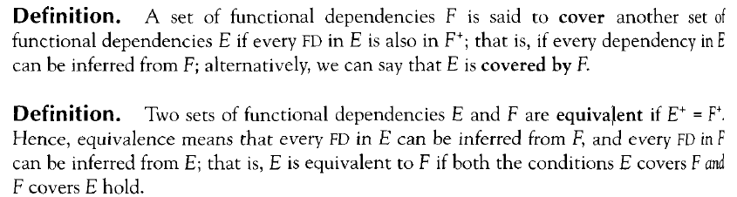
Equivalence of Sets of Functional Dependencies

Slide 12
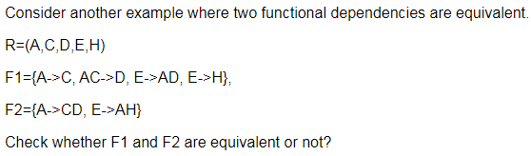
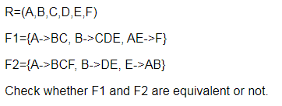
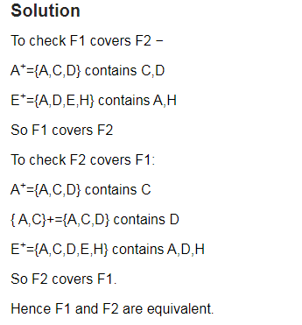
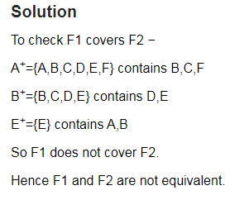
Examples:

Slide 13
Minimal Sets of FDs
A set of FDs is minimal if it satisfies the following conditions:
Every dependency in F has a single attribute for its RHS.
We cannot replace any dependency X -> A in F with a dependency Y -> A, where Y proper-subset-of X ( Y subset-of X) and still have a set of dependencies that is equivalent to F.
We cannot remove any dependency from F and have a set of dependencies that is equivalent to F.

Slide 14
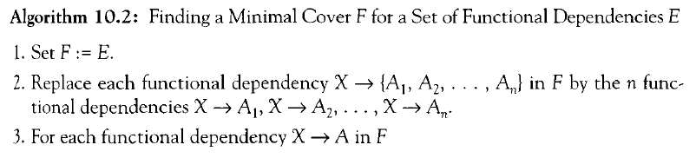
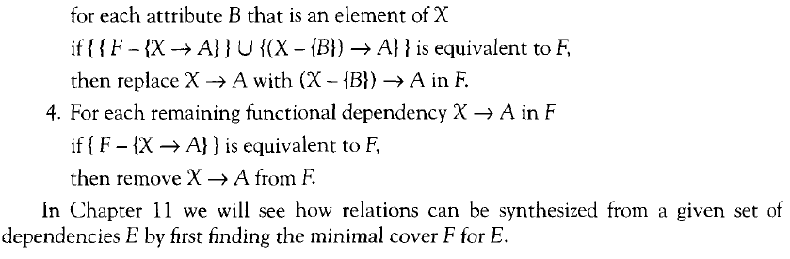
Minimal Sets of Functional Dependencies

Slide 15
Minimal Sets of FDs
Every set of FDs has an equivalent minimal set.
There can be several equivalent minimal sets.
There is no simple algorithm for computing a minimal set of FDs that is equivalent to a set F of FDs.
To synthesize a set of relations, we assume that we start with a set of dependencies that is a minimal set.

Slide 16
Find Minimal Cover/ Canonical Cover of E
Let the given set of FDs be E : {B → A, D → A, AB → D}.We have to find the minimum cover of E.
■ All above dependencies are in canonical form; so we have completed step 1 of Algorithm 10.2 and can proceed to step 2.
In step 2 we need to determine if AB → D has any redundant attribute on the left-hand side; that is, can it be replaced by B → D or A → D?
■ Since B → A, by augmenting with B on both sides (IR2), we have BB → AB, or B → AB
(i). However, AB → D as given (ii).
■ Hence by the transitive rule (IR3), we get from (i) and (ii), B → D. Hence AB → D may be replaced by B → D.
■ We now have a set equivalent to original E , say E′ : {B → A, D → A, B → D}. No further reduction is possible in step 2 since all FDs have a single attribute on the left-hand side.
■ In step 3 we look for a redundant FD in E′. By using the transitive rule on B → D and D → A, we derive B → A. Hence B → A is redundant in E’ and can be eliminated.
■ Hence the minimum cover of E is {B → D, D → A}

Slide 17
Thank you

